Slide 1
Tugas Asinkron 6 Power BI
Indeks Standar Pencemaran Udara di SPKU
2020

Slide 2
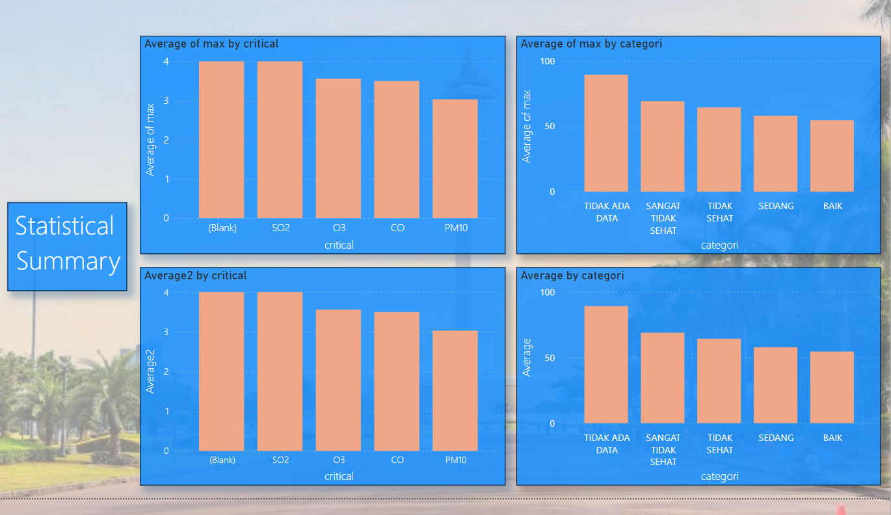
Statistical Summary

Slide 3
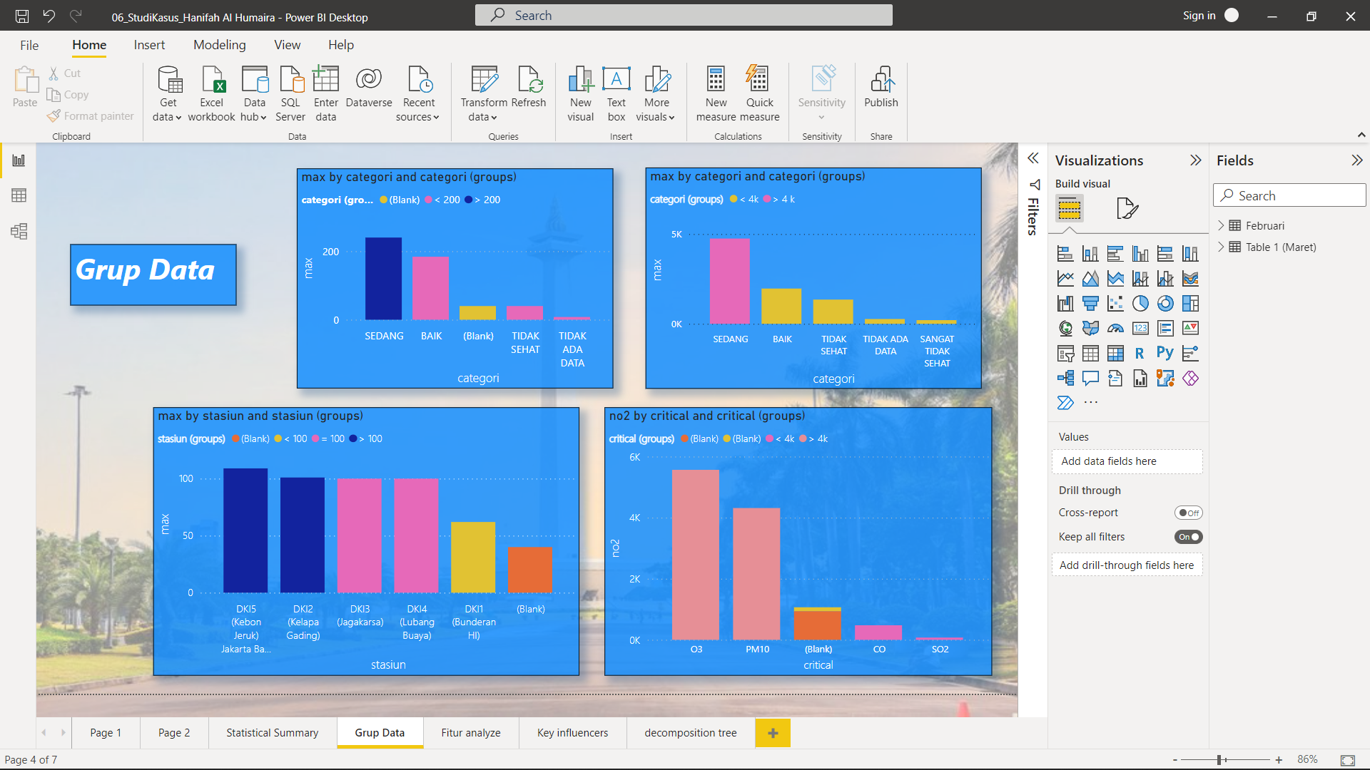
Grup Data

Slide 4
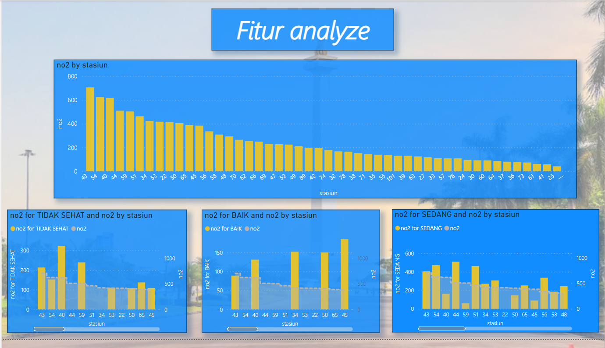
Fitur Analyze

Slide 5
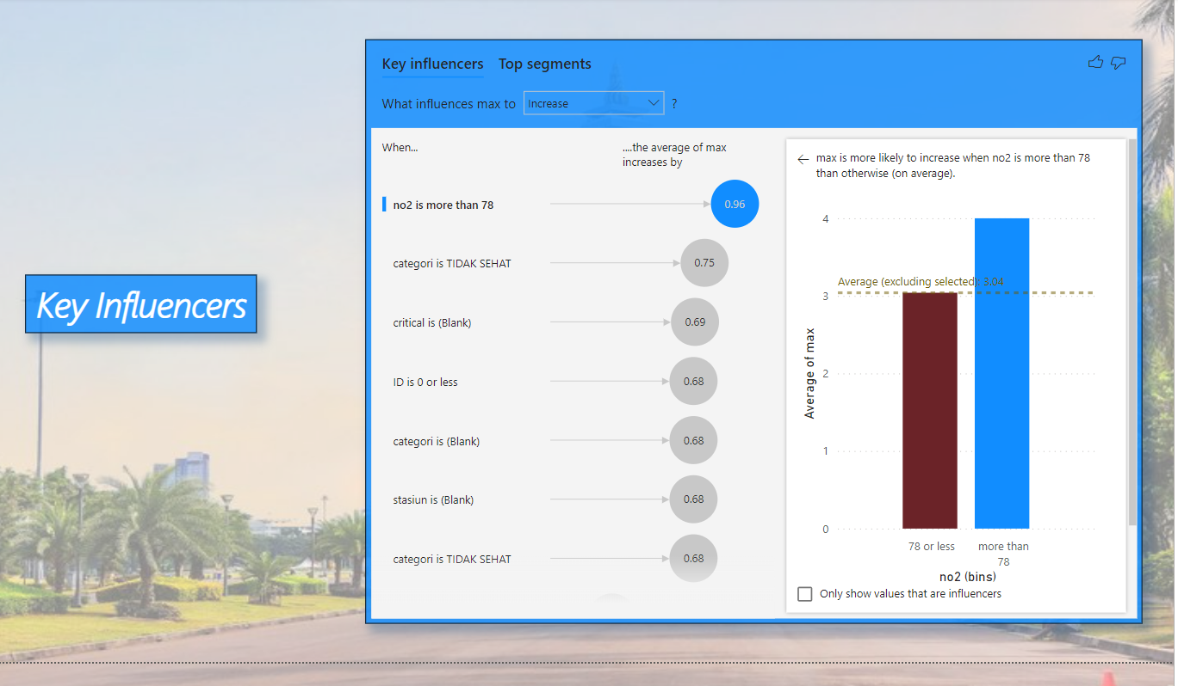
Key Influencers

Slide 6
Decomposition Tree

